Slide 1
Global Temperatures Prediction
By Kaustubha ram p
Batch No.: MIP-Ml-17

Slide 2
task
Develop a machine learning model to predict global temperatures based on historical temperature data from various geographical levels, including global, state, major city, and country-specific records.

Slide 3
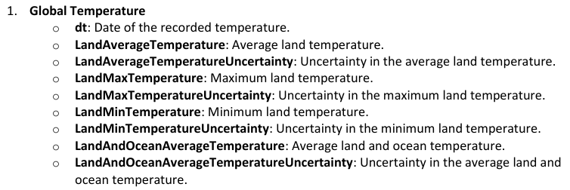
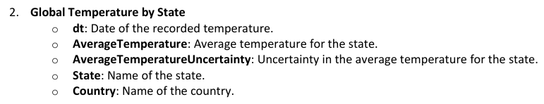
DATA

Slide 4
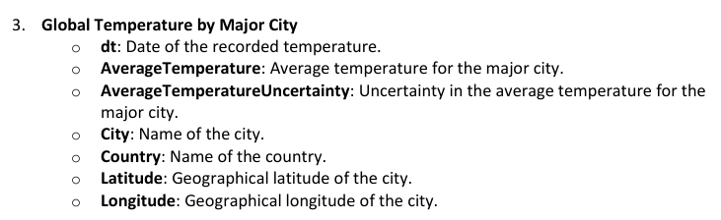
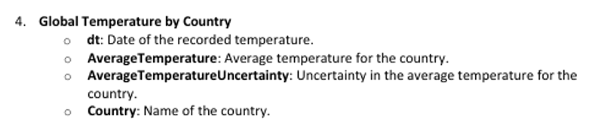
DATA

Slide 5

Import packages and read files

Slide 6
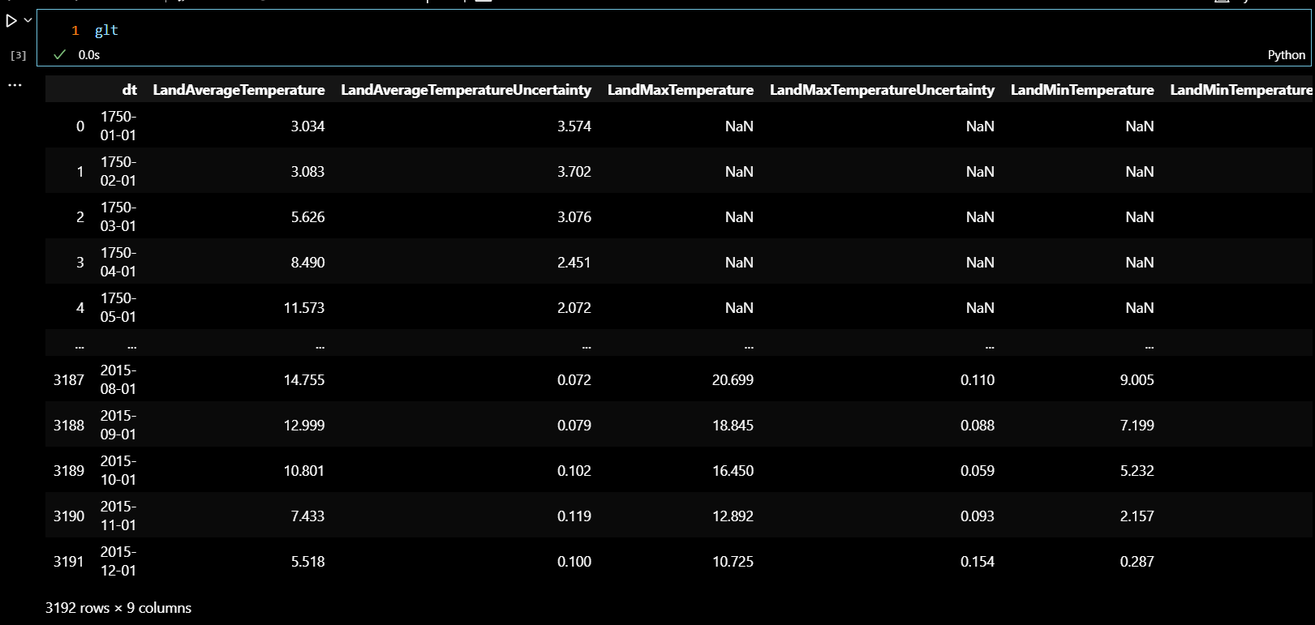
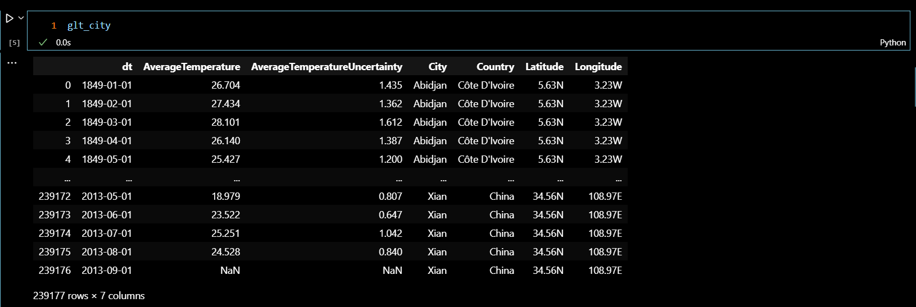
DataSet

Slide 7
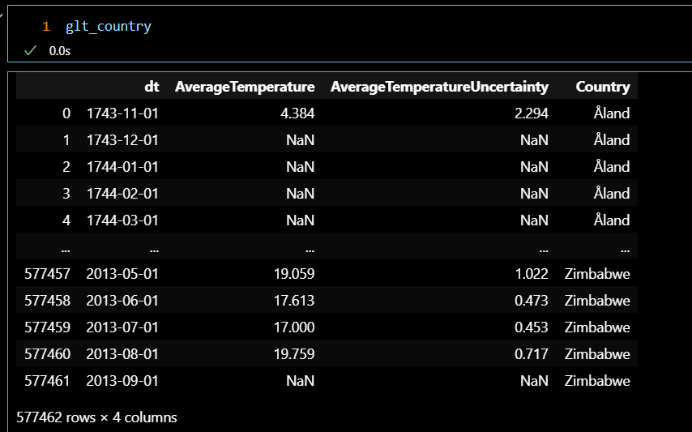
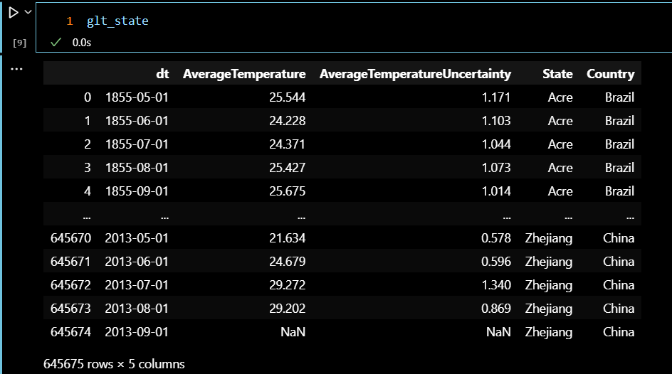
DataSet

Slide 8
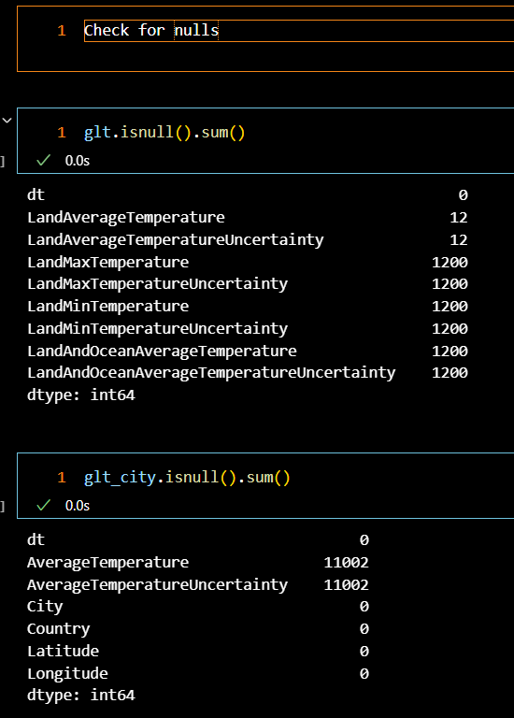
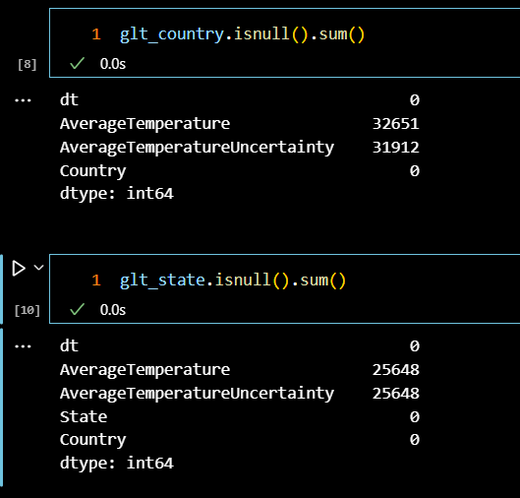
Check for nulls

Slide 9
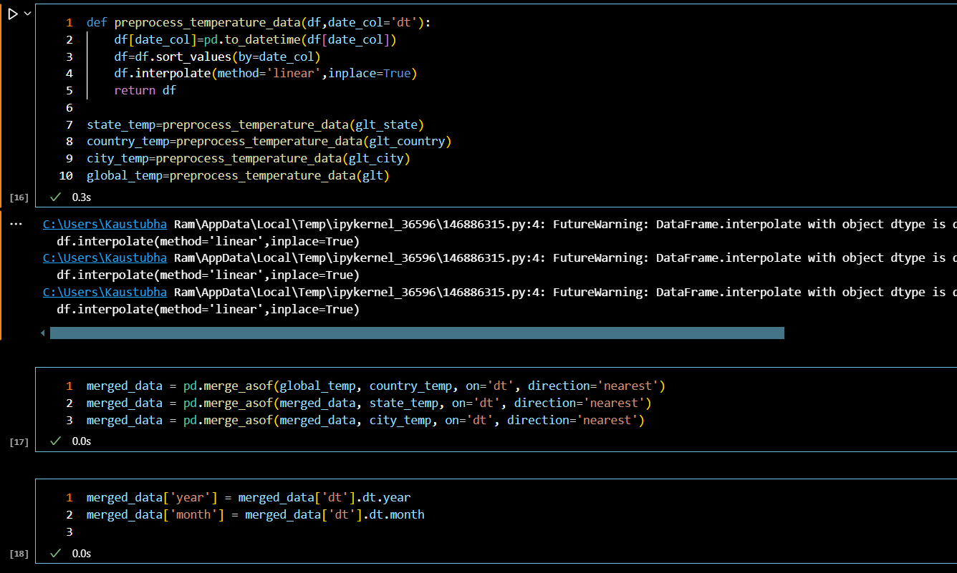
Data preprocessing

Slide 10
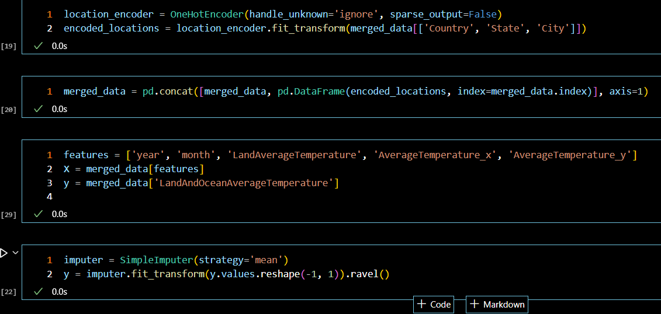
Data preprocessing

Slide 11
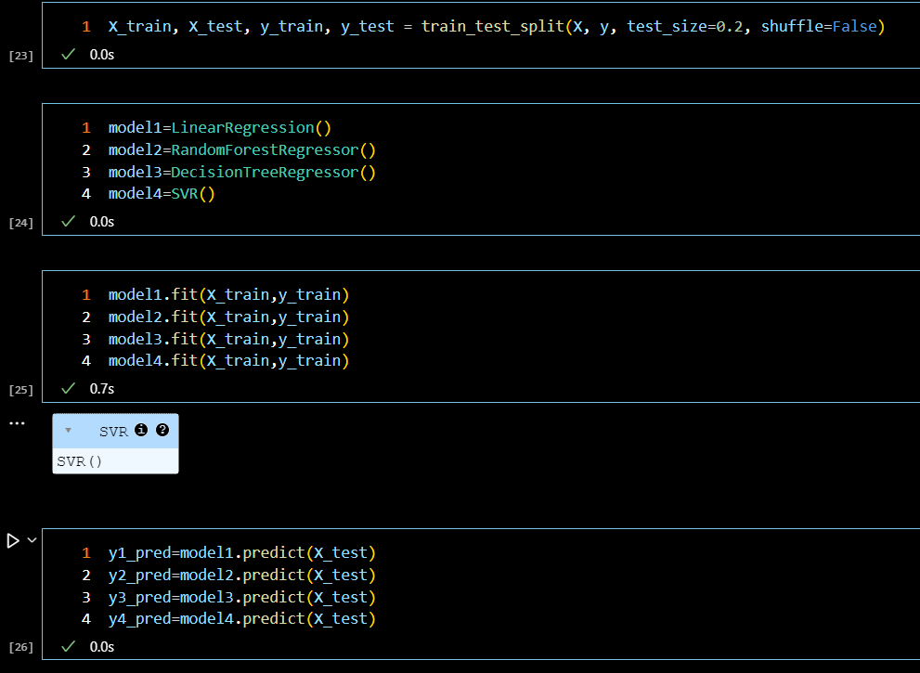
Split data into test and train data create model and fit the model

Slide 12
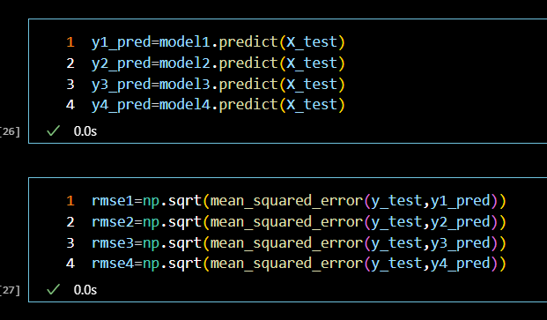
Prediction and calculate metrics

Slide 13
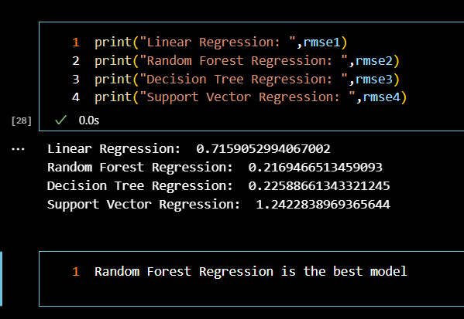
results

Slide 14
Key Insights
Global temperatures are rising at an alarming rate
Random Forest Regression gave the best prediction for the data

Slide 15
THANK YOU

